Slide 1


Team 22: Solar Home Lighting
Bi-Weekly Update 1 Jack Holdridge
Kyle Walcher
Matthew Greer
Adam Garcia
TA: Guanhua Tao
Sponsor: Won Jang
Notes:
Michelle

Slide 2
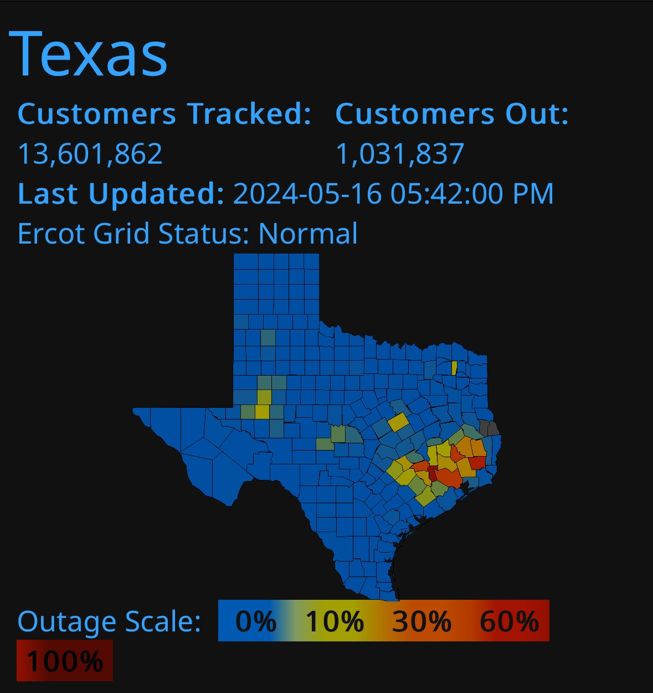
Project Summary
Problem statement:
Residential homeowners lack a reliable, unified system that monitors basic security, and remains operations during power instability. Current solutions require separate devices, each with limited functionality and poor coordination. This leads to gaps in security, unreliable operation during outages, and poor user experience.
Our Solution:
Combine security, lighting control, and user interaction into one coordinated platform
Offer flexible controls, with both local and remote capabilities.
Ensures the home remains safely lit and monitored regardless of grid fluctuations.
Notes:
Kyle

Slide 3
System Overview
Kyle Walcher
Adam Garcia
Solar panel
MPPT charge controller
Android Application
(Kotlin/Java)
3.3v Buck Converteri
12v deep cycle battery
OpenAI/Python Flask Server
ESP32-WROVER
Jack Holdridge
Matthew Greer
12v Buck Boost DC converter
3.3v Buck Converter
‹#›
Database
MCU
Touch screen HMI
ESP32
ESP32
Relay board and LED Lights
Sensors
Notes:
Eric

Slide 4
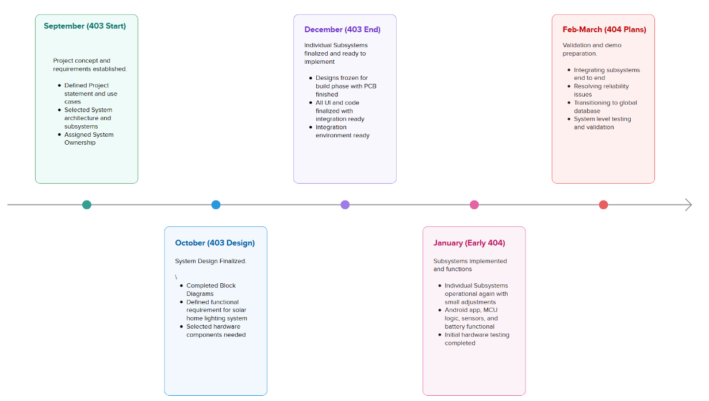
Project Timeline
Notes:
Eric

Slide 5
MPPT Charge Controller Adam Garcia
Accomplishments since 403 12hrs of effort | Ongoing progress/problems and plans until the next presentation
Tested buck converters on PCB Common ground issue Incorrect inductor sizing | Redesign charge controller PCB Ground plane Appropriately sized components Order PCB

Slide 6
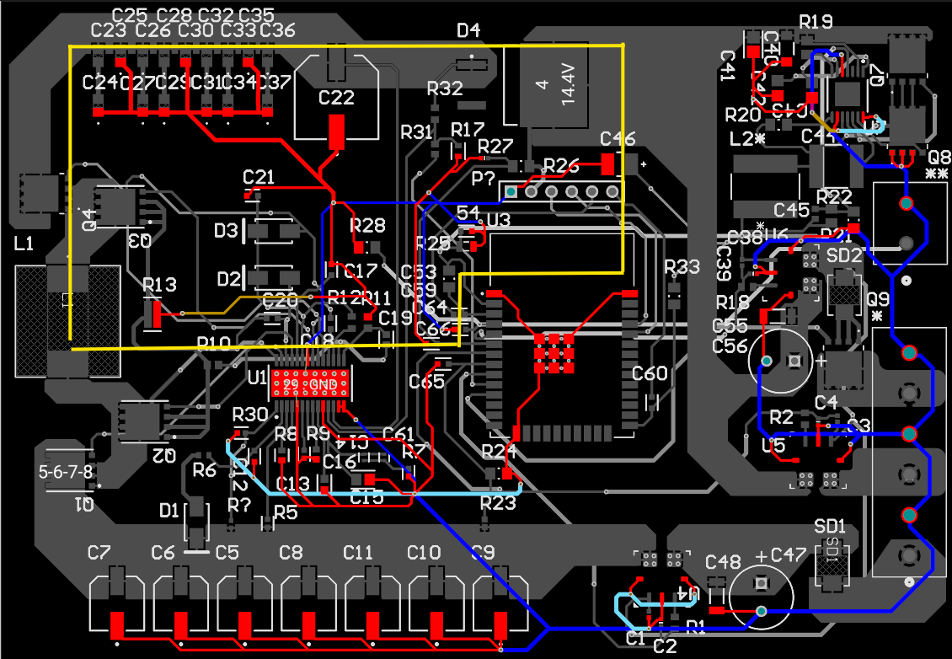
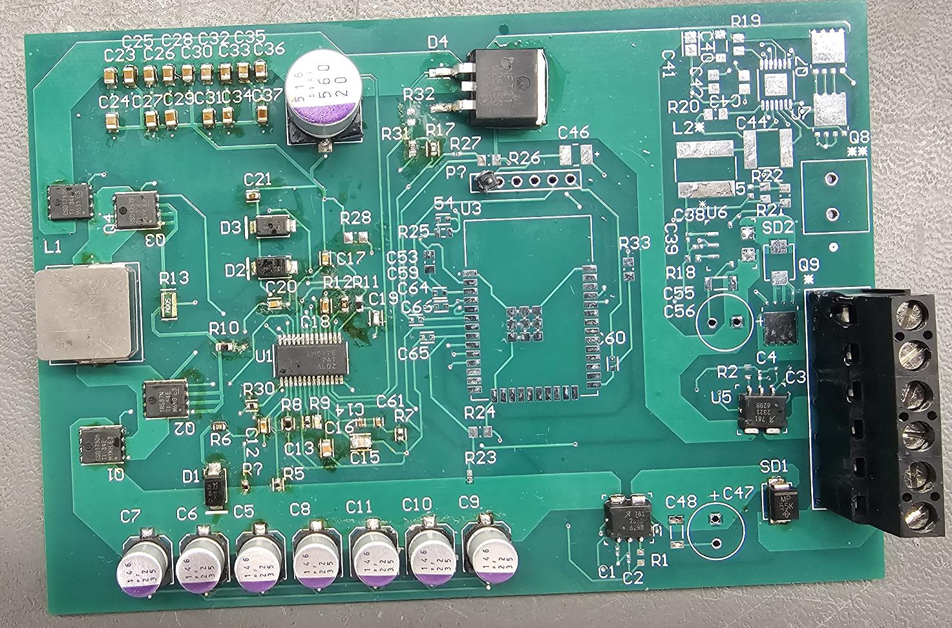
MPPT Charge Controller Adam Garcia
Missing feedback resistor
Separate ground

Slide 7
Physical Controls Jack Holdridge
Accomplishments since 403 14 hrs of effort | Ongoing progress/problems and plans until the next presentation
 | Diagnosing and repairing failed 12v converter. Updating Touchscreen code to provide improved UI. Adding Inline fuses for 12V light connections.

Slide 8
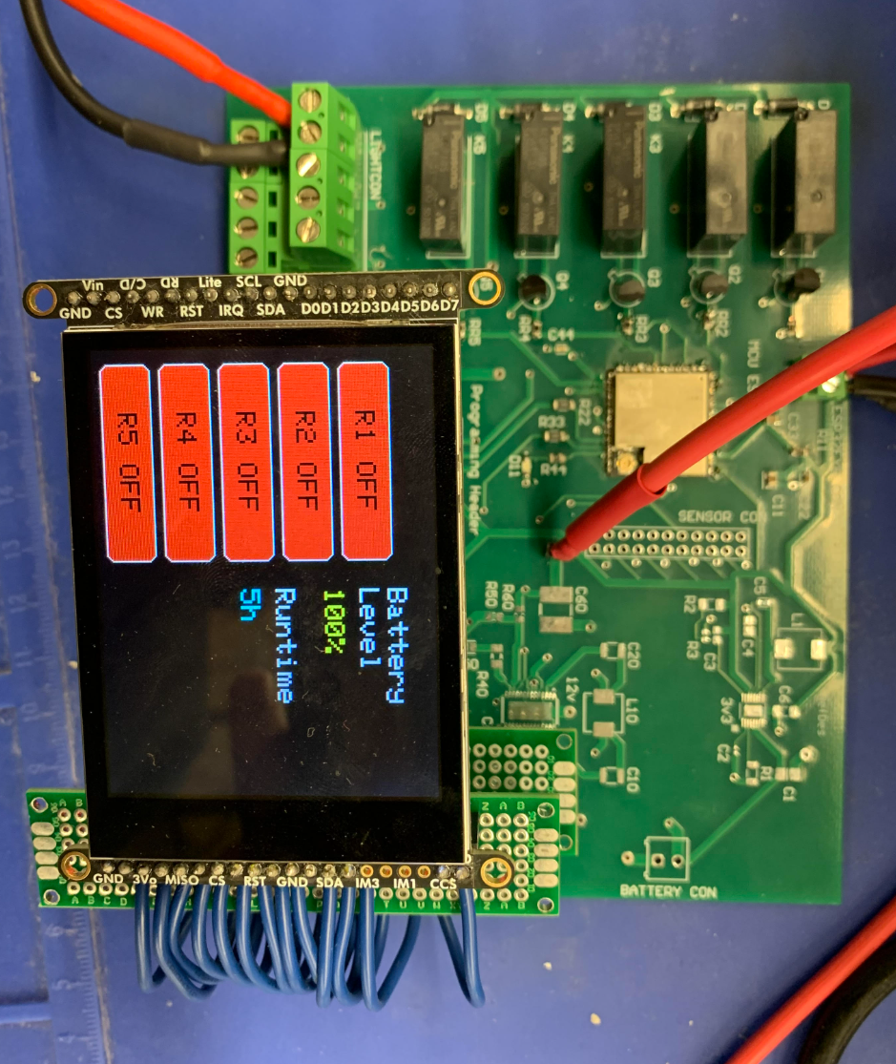
Physical Controls Jack Holdridge
Touchscreen HMI: The ESP32-S3 reliably renders the user interface, detects touch inputs, and transmits UART control commands to the main MCU.
12V Buck-Boost Converter: Exhibits instability and intermittent failure due to grounding/layout deficiencies and prior thermal overstress; redesign and revalidation are in progress.
3.3 V Buck Converter: Operates stably and meets expected performance across normal input and load conditions.

Slide 9
Android Application and Camera Kyle Walcher
Accomplishments since 403 10 hrs of effort | Ongoing progress/problems and plans until the next presentation
Added multiple user login Timestamp on Camera screenshot and AI Analysis Added Solar Panel Suggestions Based on weather | Implement global database instead of local database Add user/login capabilities (Forgot Password, profile customization, activity status) Motion sensor integration plan for AI Camera

Slide 10
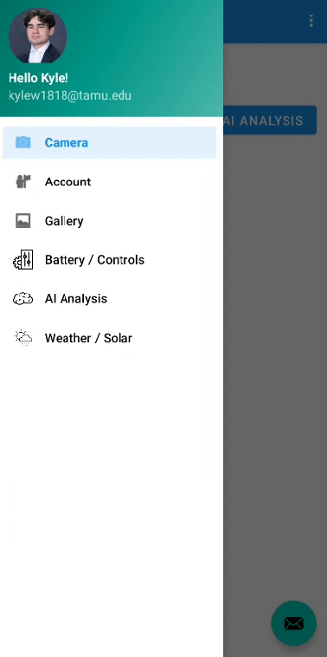
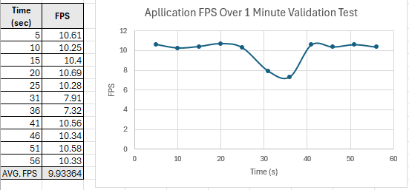
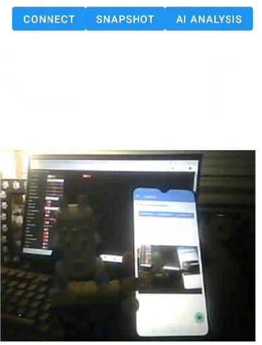
Android Application and Camera Kyle Walcher
UI/Camera Displayed on the left. Figure shows FPS over 1 minute within application. Camera Optimization and controls integration will be focused on in 404.

Slide 11
MCU, Sensors & Database Matthew Greer
Accomplishments since 403 10 Hours | Ongoing progress/problems and plans until the next presentation
Verified sensor control logic for PIR motion detection and light sensor Designed and built cloud database for storing information and remote commands Integrated Sensors, MCU logic and database completing subsystem | Latency in switch and sensor command updates when the MCU is fully running all tasks MCU connects to Wi-Fi reliably but data transfer is inconsistent Remote command changes from database aren't always received by the MCU

Slide 12
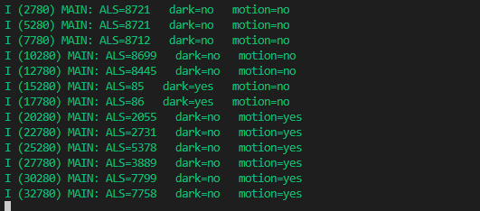
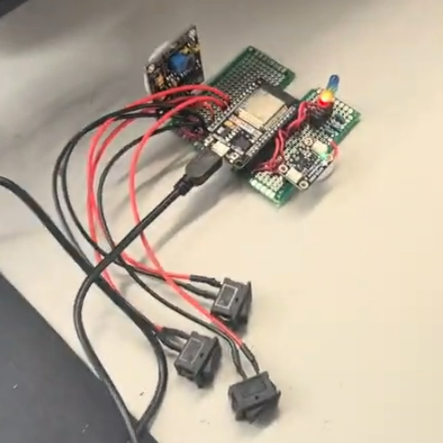
MCU, Sensors & Database Matthew Greer
Test Case | Conditions | Expected Relay Outputs | Result
Daytime, No Motion | LDR = Day, PIR = 0 | Porch: OFF • Foyer: OFF • Security: OFF | Pass
Daytime, Motion | LDR = Day, PIR = 1 | Porch: OFF • Foyer: OFF • Security: OFF | Pass
Nighttime, No Motion | LDR = Night, PIR = 0 | Porch: ON • Foyer: OFF • Security: OFF | Pass
Nighttime, Motion | LDR = Night, PIR = 1 | Porch: ON • Foyer: OFF • Security: ON | Pass
Relay: Foyer Light | Relay_Foyer = ON | Foyer: ON | Pass
Relay: Porch Light | Relay Porch = ON | Porch: ON | Pass
Relay: Security Light | Relay Security = ON | Security: ON | Pass
Fail-Safe / Fault Condition | System Fault Flag = 1 | ALL Lights = OFF (Safety Mode) | Pass

Slide 13
Parts Ordering Status
Ordered, Not Yet Received:
None at this time.
Remaining Parts to Be Ordered:
Ceiling-mounted lighting fixtures and exterior security light fixture.
Replacement 12 V buck converter IC (pending final part selection).
Redesigned Charge Controller PCB.
Thermistor
Solar Panel to PCB Male and Female connectors
Expected Completion of Parts Ordering:
All remaining components are expected to be ordered within the next 1–2 weeks, with full parts availability anticipated shortly thereafter, pending supplier lead times.
Notes:
Michelle

Slide 14
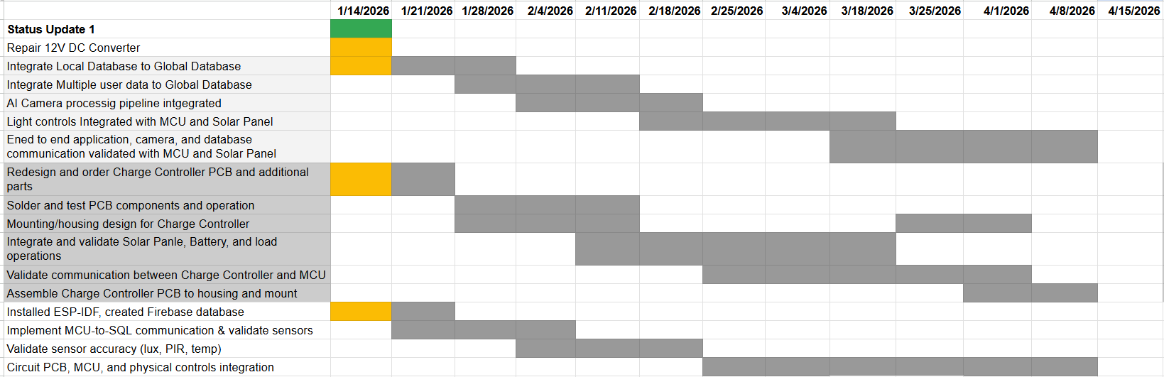
Execution & Plan
Notes:
Michelle

Slide 15
Solar Home Lighting 3:
Thank you for listening!
Questions?
Jack Holdridge
Kyle Walcher
Matthew Greer
Adam Garcia
TA: Guanhua Tao
Sponsor: Won Jang
‹#›

